Slide 1
Python and REST APIs:
Interacting With Web Services

Slide 2
Learning Objectives:
By the end of this lesson, learners will be able to:
Retrieve data provided by any web service.
Parse the data provided by any web service.
Manipulate the data provided by any web service.
Describe the Requests Module.
Explain the REST APIs.
Explain the Endpoints.
Describe the HTTP Methods
Utilize the Requests Module.
Send requests to REST API Endpoints using Python.
Create HTTP Requests to accept HTTP responses.
Define endpoints, data, and responses for a REST API.
Define HTTP (Hypertext Transfer Protocol), including its methods (e.g., GET, POST, PUT, DELETE), status codes, headers, and request/response structure.
Python and REST APIs:
Interacting With Web Services

Slide 3
Table of Contents
Overview of REST in Python
Overview of REST Architecture
What is an API?
REST APIs and Web Services
How do RESTful APIs work?
HTTP Methods
Technical Difference - GET and POST Requests
Technical Difference - Put and Patch Requests
What does the RESTful API server response contain?
Status Codes
Overview of API Endpoints
Overview of “requests” modules
Common method from “requests” module
How to make a GET Request?
How to make POST Request?
How to make a PUT Request?
How to make a PATCH Request?
How to make a DELETE Request?
HTTP Exceptions Handling
Authenticating Requests

Slide 4
Overview of REST in Python
There is an amazing amount of data available on the web. Many web services such as YouTube and GitHub make their data accessible to third-party applications through an Application Programming Interface (API). One of the most popular ways to build APIs is with the REST architecture style.
Python provides some great tools, not only to get data from REST APIs, but also to build your own Python REST APIs. By using Python and REST APIs, you can retrieve, parse, update, and manipulate the data provided by any web service.

Slide 5
Overview of REST Architecture
Representational State Transfer (REST) is a software architecture style that defines a pattern for client and server communications over a network. REST provides a set of constraints for software architecture to promote performance, scalability, simplicity, and reliability in the system. REST defines the following architectural constraints:
Stateless: The server will not maintain any state between requests from the client.
Client-server: The client and server must be decoupled from each other, allowing each to develop independently.
Cacheable: The data retrieved from the server should be cacheable, either by the client or by the server.
Uniform interface: The server will provide a uniform interface for accessing resources without defining their representation.
Layered system: The client may access the resources on the server indirectly through other layers such as a proxy or load balancer.
Code on demand (optional): The server may transfer code to the client that it can run such as JavaScript for a single-page application.
REST is not a specification but a set of guidelines on how to architect a network-connected software system.

Slide 6
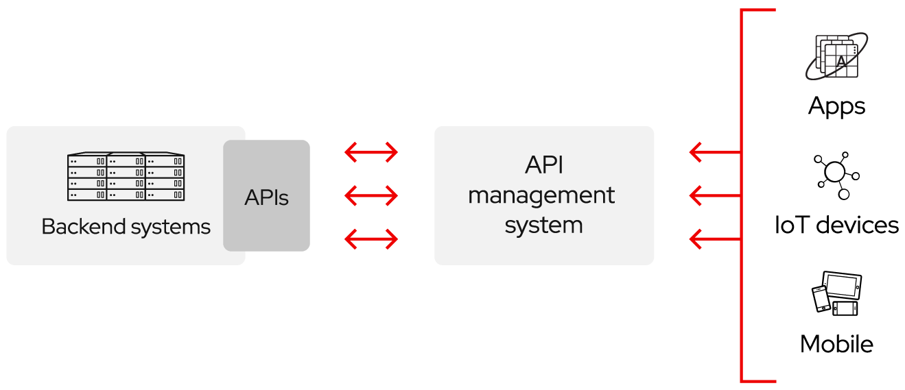
What is an API?
An Application Programming Interface (API) defines the rules that you must follow to communicate with other software systems. Developers expose or create APIs so that other applications can communicate with their applications programmatically. For example, the timesheet application exposes an API that asks for an employee's full name and a range of dates. When it receives this information, it internally processes the employee's timesheet and returns the number of hours worked in that date range.
You can think of an API as a mediator between the users or clients and the resources or web services they want to get. It is also a way for an organization to share resources and information while maintaining security, control, and authentication — determining who gets access to what.
Source: redhat
Click here for more details about API

Slide 7
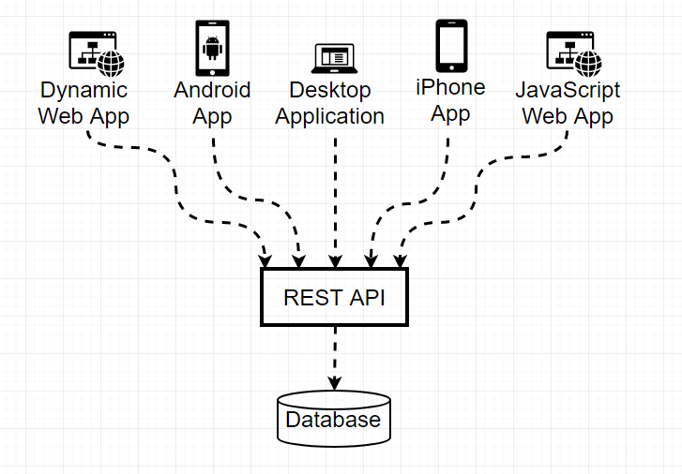
REST APIs and Web Services
A REST web service is any web service that adheres to REST architecture constraints. These web services expose their data to the outside world through an API. REST APIs provide access to web service data through public web URLs.
For example, here is one of the URLs for GitHub’s REST API: https://api.github.com/users/<username>
Source: happycoding

Slide 8
How do RESTful APIs Work?
The basic function of a RESTful API is the same as browsing the internet. The client contacts the server by using the API when it requires a resource. API developers explain how the client should use the REST API in the server application API documentation. These are the general steps for any REST API call:
The client sends a request to the server. The client follows the API documentation to format the request in a way that the server understands.
The server authenticates the client and confirms that the client has the right to make that request.
The server receives the request and processes it internally.
The server returns a response to the client. The response contains information that tells the client whether the request was successful. The response also includes any information that the client requested.
The REST API request and response details vary slightly depending on how the API developers design the API.

Slide 9
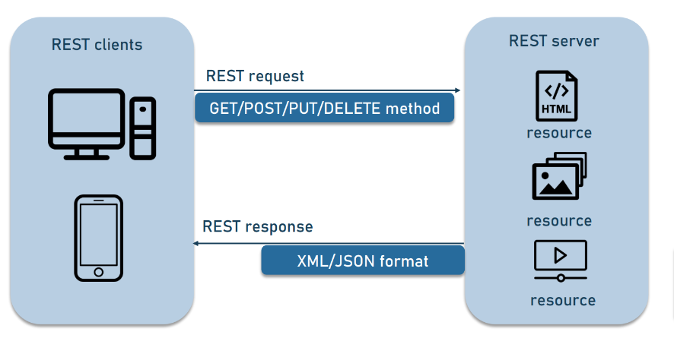
How do RESTful APIs Work? (continued)
A REST client can interact with each resource by sending an HTTP request.
Source: altexsoft

Slide 10
HTTP Methods
HTTP methods are used to define the action that the client wants to perform on the resource.
There are eight standard HTTP methods:
GET: Retrieve a resource.
POST: Create a new resource.
PUT: Update an existing resource.
DELETE: Delete a resource.
HEAD: Retrieve the headers of a resource.
OPTIONS: Query the capabilities of the resource.
TRACE: Echo back the request message.
CONNECT: Establish a tunnel to a remote server.

Slide 11
Technical Difference - GET and POST Requests
There are technical level differences between a GET request and a POST request. There is of course, a difference in the METHOD type, but also in the request payload:
A POST request will contain all of the data necessary for creating a new object. Using the post(), we can perform changes to the server.
A GET request is used for reading something. Using get(), data is retrieved from the server.
The parameters of the GET request are used for identifying which piece of data the client would like to read.
The parameters of the POST request are used for defining a new piece of data.

Slide 12
Technical Difference - Put and Patch Requests
So, wait — there are five REST methods, but only four CRUD methods?
PUT and PATCH are both used for updating. Whenever you update your Facebook profile, you are probably making a PUT or PATCH request. The difference is that PUT would be intended to completely replace your profile; whereas, PATCH would be intended to just change a few fields of your profile.
To clarify further, PATCH is replacing part of the data and PUT is replacing the whole thing.

Slide 13
What Does the RESTful API Server Response Contain?
REST principles require the server response to contain the following main components:
Status Code: The status code contains a three-digit status code that communicates request success or failure. For instance, the 2XX codes indicate success, but the 4XX and 5XX codes indicate errors. The 3XX codes indicate URL redirection.
The following are some common status codes:
200: Generic success response.
201: POST method success response.
400: Incorrect request that the server cannot process.
404: Resource not found.
Message Body: The response body contains the resource representation. The server selects an appropriate representation format based on what the request headers contain. Clients can request information in XML or JSON formats, which define how the data is written in plain text. For example, if the client requests the name and age of a person named John, the server returns a JSON representation as follows:
'{"name":"John", "age":30}'
Headers: The response also contains headers or metadata about the response. They give more context about the response and include information such as the server, encoding, date, and content type.

Slide 14
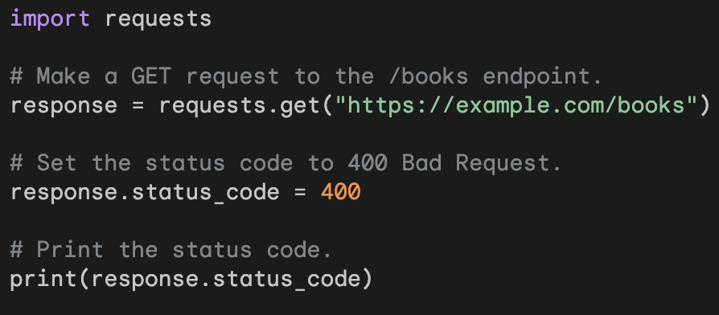
Status Codes
HTTP status codes are used to indicate the status of an HTTP response.
They are three-digit codes that begin with a number from 1 to 5.
The first digit indicates the class of the status code.
1xx: Informational
2xx: Success
3xx: Redirection
4xx: Client Error
5xx: Server Error
The second and third digits provide more specific information about the status code.
This code makes a GET request to the /books endpoint of the API. The requests library is used to make the request. The status_code attribute of the response object is used to set the status code to 400 Bad Request. The print() function is used to print the status code.
Click here for more details about status code.

Slide 15
Overview of API Endpoints
An API Endpoint is a specific location within an API that accepts requests and sends back responses.
It is a way for different systems and applications to communicate with each other by sending and receiving information and instructions via the endpoint.
Endpoints are typically URLs, but they can also be other types of addresses such as IP addresses or file paths.
The specific format of an endpoint depends on the API that it is part of.
Some common types of API endpoints include:
GET endpoints: These endpoints are used to retrieve data from the API.
POST endpoints: These endpoints are used to create new data in the API.
PUT endpoints: These endpoints are used to update existing data in the API.
DELETE endpoints: These endpoints are used to delete data from the API
When using an API endpoint, you need to specify the following information the endpoint URL, the HTTP method, any required parameters, and any required headers.

Slide 16
Example: API Endpoints
To help clarify this, take a look at the table below. In this table, you will see API endpoints for a hypothetical CRM system. These endpoints are for a customer resource that represents potential customers in the system:
HTTP method | API endpoint | Description
GET | /customers | Get a list of customers.
GET | /customers/<customer_id> | Get a single customer.
POST | /customers | Create a new customer.
PUT | /customers/<customer_id> | Update a customer.
PATCH | /customers/<customer_id> | Partially update a customer.
DELETE | /customers/<customer_id> | Delete a customer.
Each of the endpoints performs a different action based on the HTTP method.
In reality, you will need the full URL path to access an API endpoint:
https://api.example.com/customers

Slide 17
Check Your Knowledge
What is REST API?
How does REST API work?
Describe the HTTP Methods.
What is the Status Code in HTTP request and response.

Slide 18
Overview of “requests” Modules
To write code that interacts with REST APIs, we can use the requests module to send all kinds of HTTP requests. It is an easy-to-use library with many features ranging from passing parameters in URLs to sending custom headers and SSL verification.
Requests allow you to send HTTP/1.1 requests. You can add headers, form data, multi-part files, and parameters with simple Python dictionaries and access the response data in the same way.
To start using requests , you need to install it first. You can use pip to install it:
For Terminal: pip install requests
For Jupyter Notebook: !pip install requests
Notes:
The exclamation mark (!) is used in Jupyter Notebook cells to execute shell commands. This allows you to run pip install requests directly from within the notebook.

Slide 19
Common Method from “requests” Module
Method | Description
delete(url, args) | Sends a DELETE request to the specified url and Delete a record/records.
get(url, params, args) | Sends a GET request to the specified url and Get a record/records.
head(url, args) | Sends a HEAD request to the specified url.
patch(url, data, args) | Sends a PATCH request to the specified url and Partially update a record.
post(url, data, json, args) | Sends a POST request to the specified url and Create a new record.
put(url, data, args) | Sends a PUT request to the specified url and Update a record.
request(method, url, args) | Sends a request of the specified method to the specified url

Slide 20
How to Make a GET Request
It is fairly straightforward to send an HTTP request using Requests. You start by importing the module and then make the request using the get() method.
The get() method sends a GET request to a web server and it returns a response object.
An important thing to note is that GET is a read-only operation, which means that it is only suitable for accessing existing resources but should not be used to modify them.
Syntax:
import requests
requests.get("url", **kwargs)
**kwargs are any number of dictionary items (named arguments) that are passed in as parameters. Many different named parameters can be passed into a GET request. For example, they can be used to include cookies in the request, set proxies, set user-agents, or set a page timeout.

Slide 21
Example 1: How to Make a GET Request
This example demonstrates how to interact with HTTP responses using the requests library, accessing various attributes and content formats returned by the server.
import requests
response = requests.get("https://jsonplaceholder.typicode.com/users")
response.status_code # returns 200
print(response.encoding) # returns 'utf-8'
print(response.status_code) # returns 200
print(response.url)
#get the time elapsed between sending the request and getting back a response using another property.
print(response.elapsed) # returns datetime.timedelta(0, 1, 666890)
print(response.history)
print(response.headers)
print(response.headers['Content-Type'])
print("-----------###############-------")
print(response.text) # content accessing in text format
print("-----------###############-------")
print(response.content) # return binary format
print("-----------###############-------")
print("-----------###############-------")
print(response.json())# JSON Response Content or Parse the JSON data from the response
Notes:
To demonstrate how the request module works, we will use JSONPlaceholder, which is a freely available fake API used for testing and prototyping.
It is fairly straightforward to send an HTTP request using Requests. You start by importing the module, and then making the request using get() method. Check out the example:

Slide 22
Example 2: How to Make a GET Request
Get only one record: Let’s make change in the URL in the previous example, as shown below.
import requests
# The API endpoint
url = "https://jsonplaceholder.typicode.com/posts/1"
# A GET request to the API
response = requests.get(url)
# Print the response
response_json = response.json()
print(response_json)
Output:
{'userId': 1, 'id': 1, 'title': 'sunt aut facere repellat provident occaecati excepturi optio reprehenderit', 'body': 'quia et suscipit\nsuscipit recusandae consequuntur expedita et cum\nreprehenderit molestiae ut ut quas totam\nnostrum rerum est autem sunt rem eveniet architecto'}

Slide 23
Example 3: How to Make a GET Request?
Passing Argument: You can also pass arguments to a Python GET request. To do this, we must slightly alter the code above. Here is how the new code looks.
Output:
import requests
# The API endpoint
url = "https://jsonplaceholder.typicode.com/users"
# Adding a payload
payload = {"id": [1, 2, 3], "userId":1}
# A get request to the API
response = requests.get(url, params=payload)
# Print the response
response_json = response.json()
for i in response_json:
print(i, "\n")
{'id': 1, 'name': 'Leanne Graham', 'username': 'Bret', 'email': 'Sincere@april.biz', 'address': {'street': 'Kulas Light', 'suite': 'Apt. 556', 'city': 'Gwenborough', 'zipcode': '92998-3874', 'geo': {'lat': '-37.3159', 'lng': '81.1496'}}, 'phone': '1-770-736-8031 x56442', 'website': 'hildegard.org', 'company': {'name': 'Romaguera-Crona', 'catchPhrase': 'Multi-layered client-server neural-net', 'bs': 'harness real-time e-markets'}}
{'id': 2, 'name': 'Ervin Howell', 'username': 'Antonette', 'email': 'Shanna@melissa.tv', 'address': {'street': 'Victor Plains', 'suite': 'Suite 879', 'city': 'Wisokyburgh', 'zipcode': '90566-7771', 'geo': {'lat': '-43.9509', 'lng': '-34.4618'}}, 'phone': '010-692-6593 x09125', 'website': 'anastasia.net', 'company': {'name': 'Deckow-Crist', 'catchPhrase': 'Proactive didactic contingency', 'bs': 'synergize scalable supply-chains'}}
{'id': 3, 'name': 'Clementine Bauch', 'username': 'Samantha', 'email': 'Nathan@yesenia.net', 'address': {'street': 'Douglas Extension', 'suite': 'Suite 847', 'city': 'McKenziehaven', 'zipcode': '59590-4157', 'geo': {'lat': '-68.6102', 'lng': '-47.0653'}}, 'phone': '1-463-123-4447', 'website': 'ramiro.info', 'company': {'name': 'Romaguera-Jacobson', 'catchPhrase': 'Face to face bifurcated interface', 'bs': 'e-enable strategic applications'}}
Notes:
Here’s what we did differently:
Changed the API endpoint. Notice it no longer has a ‘1’ at the end.
Defined the payload in a dictionary.
Passed the payload to the param argument of the requests.get() method.
This returned a list object so we looped through the list and printed each item on a new line.

Slide 24
How to Make a POST Request?
The post() method sends a POST request to a web server and it returns a response object. This can be useful when you are creating a new resources, new data, and automatically submitting forms.
Syntax:
import requests
requests.post("url", **kwargs)

Slide 25
Example 1: How to Make a POST Request
Let’s take a look at how we can create new data on the JSONPlaceholder server.
# Define new data to create
new_data = {
"userID": 1,
"id": 1,
"title": "Making a POST request",
"body": "This is the data we created."
}
# The API endpoint to communicate with
url_post = "https://jsonplaceholder.typicode.com/posts"
# A POST request to tthe API
post_response = requests.post(url_post, json=new_data)
# Print the response
post_response_json = post_response.json()
print(post_response_json)
Output:
{'userID': 1, 'id': 101, 'title': 'Making a POST request', 'body': 'This is the data we created.'}
Notes:
In the code above, we performed the following:
Created a new resource we wanted to add to the JSONPlaceholder API
Defined the endpoint to POST the new data
Sent a POST request using the requests.post() method. Note that the json parameter was set in the post() method; we do this to tell the API we are explicitly sending a JSON object to the specified URL.
Used the response.json() method to store the response data in a dictionary object
The last step is to print the JSON response data.

Slide 26
How to Make a PUT Request
The put() method sends a PUT request to a web server and returns a response object.
The put() method is generally used for update operations, and post() for create operations.
Any data sent with a PUT request will completely replace the existing values.
It is idempotent, which means that calling it multiple times with the same data will have the same effect as calling it once.
import requests
requests.put("url", **kwargs)
**kwargs are any number of dictionary items (named arguments) that are passed in as parameters. Many different named parameters can be passed in to a PUT request. For example, they can be used to include cookies in the request, set proxies, set headers, or set a page timeout.

Slide 27
Example: How to Make a PUT Request
The following code sends a PUT request to update existing posts with new data. Any data sent with a PUT request will completely replace the existing values of the posts.
This time will append 11 to the end of the URL. This tells the REST API which posts you would like to update:
import requests
api_url = "https://jsonplaceholder.typicode.com/posts/11"
response = requests.get(api_url)
print(response.json())
todo = {"userId": 1, "title": "Wash car", "completed": True}
response = requests.put(api_url, json=todo)
print(response.json())
#{'userId': 1, 'title': 'Wash car', 'completed': True, 'id': 10}
response.status_code

Slide 28
How to Make a PATCH Request
We can use patch() to modify the value of a specific field on an existing Data. PATCH differs from PUT in that it does not completely replace the existing resource. It only modifies the values set in the JSON sent with the request.
It is not idempotent, which means that calling it multiple times with the same data may not have the same effect.
Output:
import requests
api_url = "https://jsonplaceholder.typicode.com/posts/11"
todo = {"title": "Mow lawn"}
response = requests.patch(api_url, json=todo)
print(response.json())
response.status_code
When you call response.json(), you can see that title was updated to Mow lawn.

Slide 29
How to Make a DELETE Request
The delete() method sends a DELETE request to a web server; it returns a response object.
If you want to completely remove a resource, then you use DELETE. Here is the code to remove a todo:
import requests
api_url = "https://jsonplaceholder.typicode.com/posts/10"
response = requests.delete(api_url)
result = response.json()
print(result)
response.status_code
#Output: {}

Slide 30
HTTP Exceptions Handling
Some exceptions may occur while communicating with a remote server. For instance, the server can be unreachable, the requested URL does not exist on the server, or the server does not respond in a proper time frame
We can use the HTTPError class of the requests module to detect and resolve HTTP errors.
The raise_for_status() method throws an exception whenever the HTTP response contains an error status code (4XX client error or 5XX server error response). The requests module does not raise an exception automatically once an error occurs; therefore, we need to use the raise_for_status() method to identify whether an error status code has been raised or not. Finally, the exception handler block catches the error.

Slide 31
Example: Handling HTTP Exceptions
Let’s go back to the JSONPlaceholder API for this demonstration. We will start by writing some code, and then explain what is going on.
import requests
from requests import HTTPError
# A deliberate typo is made in the endpoint "postz" instead of "posts"
url = "https://jsonplaceholder.typicode.com/postz"
# Attempt to GET data from provided endpoint
try:
response = requests.get(url)
response.raise_for_status()
# If the request fails (404) then print the error.
except HTTPError as error:
print(error)
Output:
404 Client Error: Not Found for url: https://jsonplaceholder.typicode.com/postz

Slide 32
Authenticating Requests
Authentication means validating a client to determine whether or not they can access an API. This serves several purposes:
Limiting requests to an API.
Filtering malicious requests.
To implement authentication, we need to import the following module present in requests module:
from requests.auth import HTTPBasicAuth
The HTTPBasicAuth module is present in requests.auth and has classes and methods to detail with HTTP Authentication.
An Authentication object needs to be created and passed to the get() body method using the 'Auth' key. We are trying to authenticate a user who is trying to login using a username and password. If the username and password entered by the client do not match the credentials present in the server's database, the server will throw a 403 forbidden error, else a 200 OK response.
Syntax:
response = requests.get('url',auth = HTTPBasicAuth('username', 'password'))
print(response.status_code)

Slide 33
Example: Authenticating Requests
Up to this point, the interactions we had with the REST API have been pretty straightforward. The JSONPlaceholder API does not require any authentication for you to start interacting with it, but there are several instances where a REST API may require authentication before access is granted to specific endpoints – especially when you are dealing with sensitive data.
For example, if you want to create integrations, retrieve data, and automate your workflows on GitHub, you can do so with GitHub REST API. However, there are many operations on the GitHub REST API that require authentication such as retrieving public and private information about authenticated users.
Here is a simple workaround using the Python requests module:
from requests.auth import HTTPBasicAuth
private_url = "https://api.github.com/user"
github_username = "username"
token = "token"
private_url_response = requests.get(
url=private_url,
auth=HTTPBasicAuth(github_username, token)
)
private_url_response.status_code

Slide 34
Guided Labs
Complete the following labs. You can find these labs on Canvas under the Assignment section.
Guided LAB - 342.2.1 - Real World Example - Get products from REST API
Guided LAB 342.2.2 - File Handling, XML Handling, and RESTful Web Services in Python

Slide 35
Knowledge Check
What is REST in Python?
What is an API?
What is difference between REST APIs and Web Services
How do RESTful APIs work?
What is difference between GET and POST Requests
What is difference between Put and Patch Requests
What does the RESTful API server response contain?
What is Status Codes
What is an API Endpoints

Slide 36
Practice Activities
Complete the following Practice Activities. You can find these activities on Canvas under the Assignment section.
ACT - 342.2.1 - Advanced Python - Cumulative Lab1
ACT - 342.2.2 - Advanced Python - Cumulative Lab2.
Note:These practice activities are supplementary and optional for further practice. If you have technical questions while performing the practice activities, ask your instructors for assistance.

Slide 37
Summary
REST (Representational State Transfer) is an architectural style of networked systems. It is not a standard itself, but does use standards such as HTTP, URL, XML, etc. JSON is the most popular data exchange format in RESTful web services. REST API is a way of accessing web services in a simple and flexible way without having any processing.
An Application Programming Interface (API) is a set of programming instructions for accessing a web-based software application.
There are four methods involved in REST API: 1) GET, 2) POST, 3) Delete, and 4) PUT.
The Requests module is one of the integral parts of Python for making HTTP requests to a specified URL.
The Python requests module has several built-in methods to make HTTP requests to specific URLs using GET, POST, PUT, PATCH or HEAD requests. A HTTP request is meant to either retrieve data from a specified URL or to push data to a server. It works as a request-response protocol between a client and a server.

Slide 38
References
https://realpython.com/api-integration-in-python/
https://www.scaler.com/topics/requests-module-in-python/
https://requests.readthedocs.io/en/latest/
How to fix ConnectTimeout error in Python requests?
How to fix MissingSchema error in Python requests?
How to fix ReadTimeout error in Python requests?
How to fix SSLError in Python requests?
How to fix TooManyRedirects error in Python requests?
What is requests used for in Python?

